Slide 1
Wasserstein GAN for cell images
Zheng Lu

Slide 2
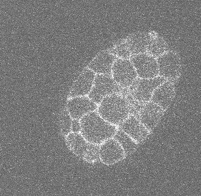
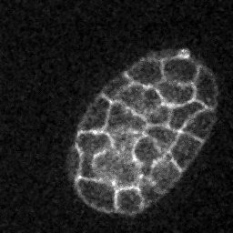
Input image preprocess using ImageJ
Each image stack has 30 slices. I only use the 10th-20th, as they look similar in shape and size.
We have 76 stacks, resulting in 760 training images.

Slide 3
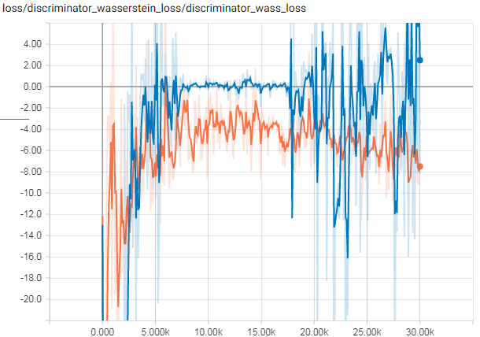
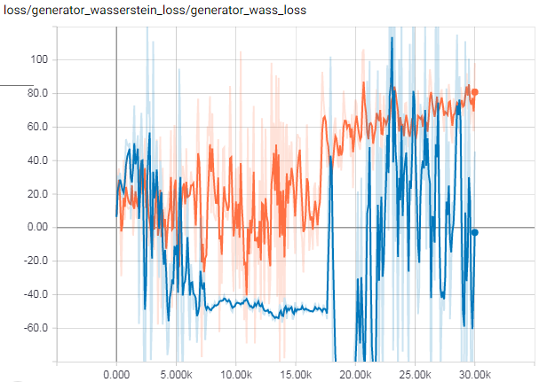
Loss for batch 1
Adam optimizor, [-4, -4], [-5, -4]

Slide 4
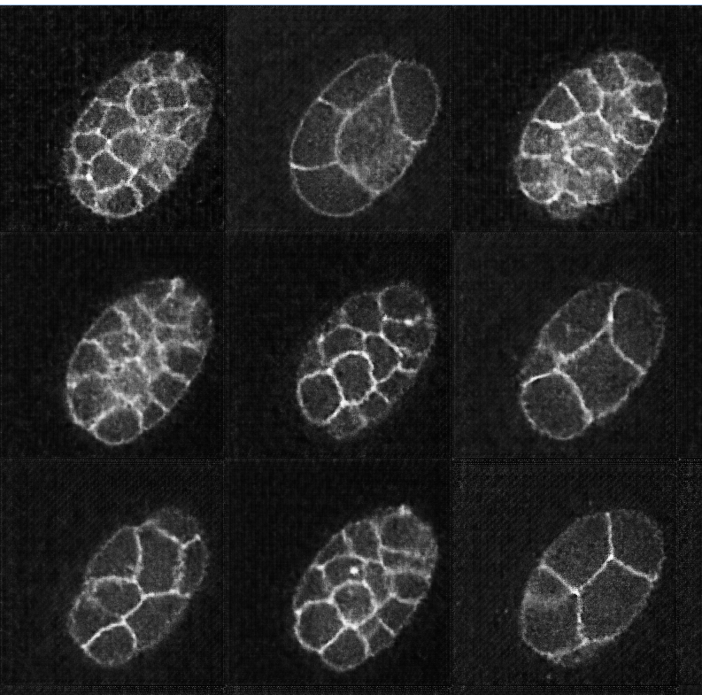
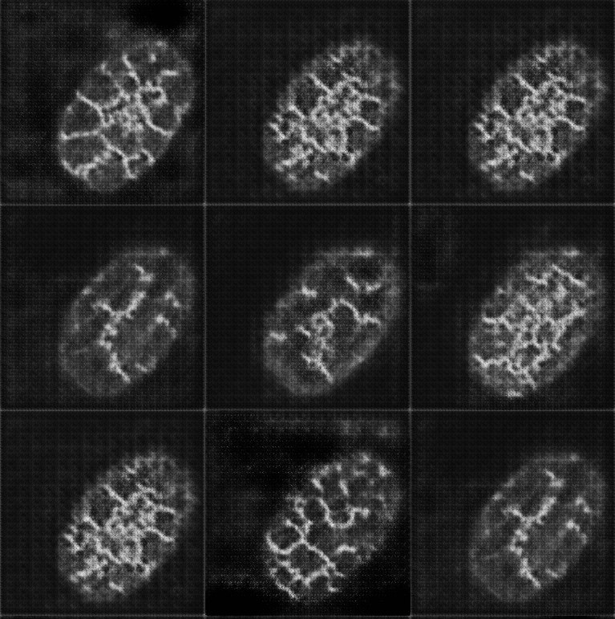
Sample Image for batch 1
Unconditional
Conditional

Slide 5
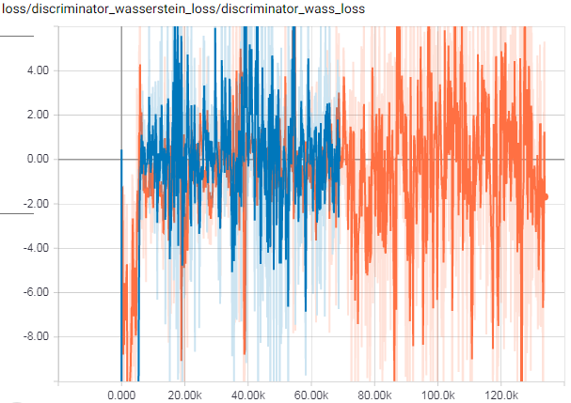
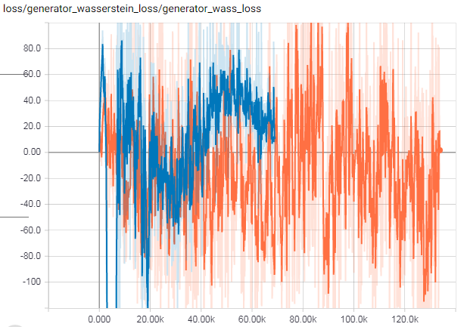
Loss for batch 2
RMSProp optimizor, [-4, -4], [-5, -4]

Slide 6
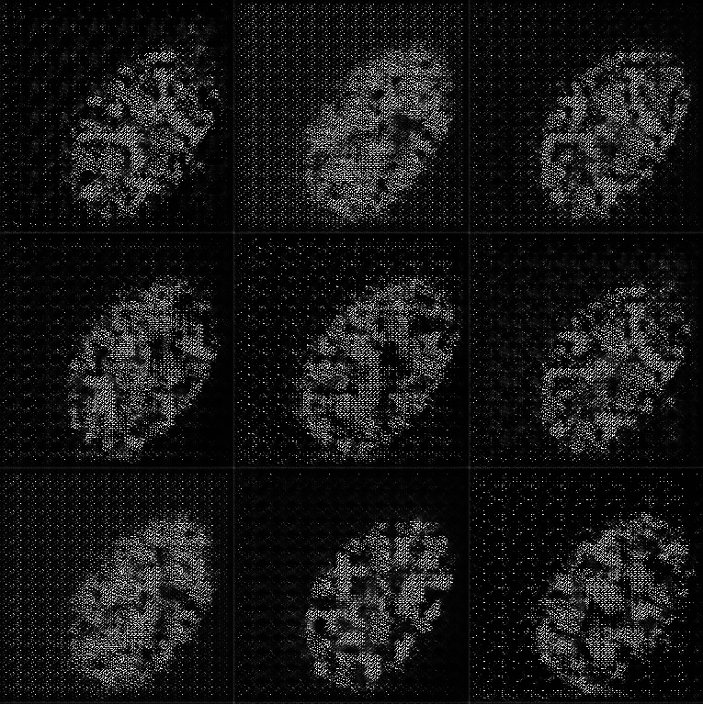
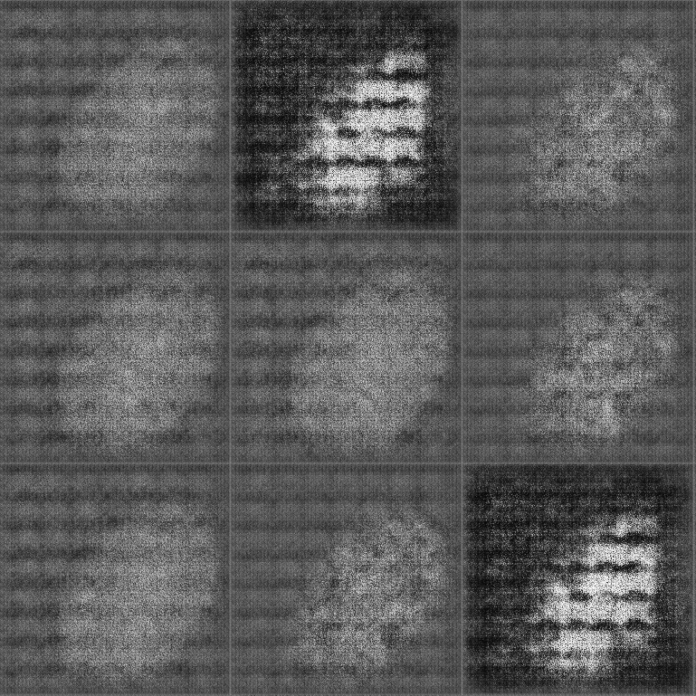
Sample Image for batch 2
Unconditional
Conditional

Slide 7
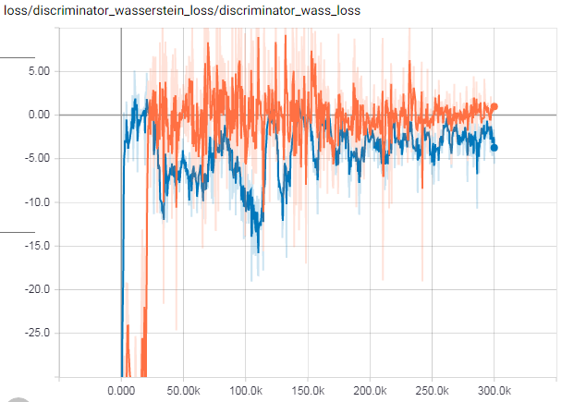
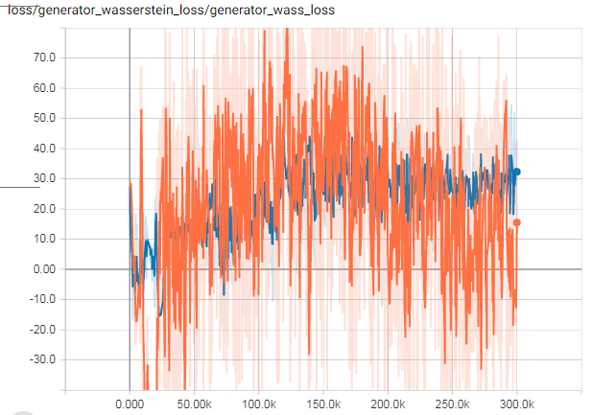
Loss for batch 3
Adam optimizor, [-5, -5], [-6, -5]

Slide 8
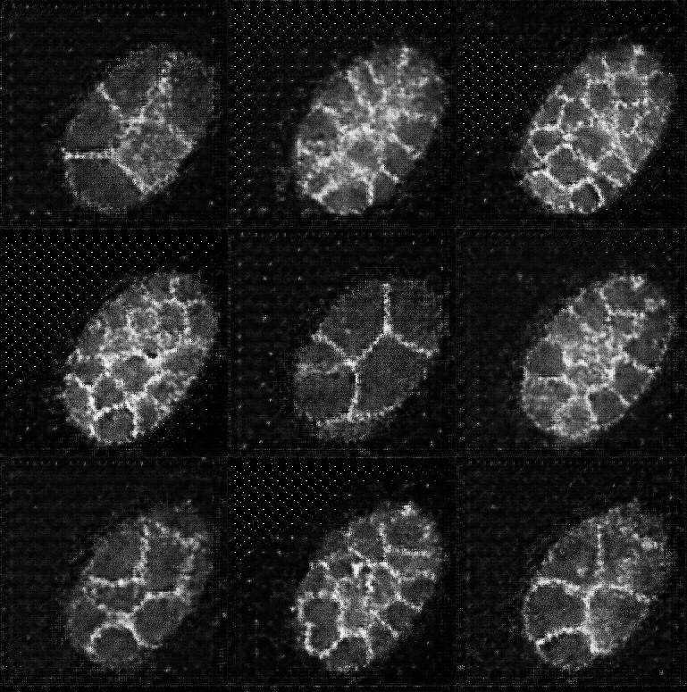
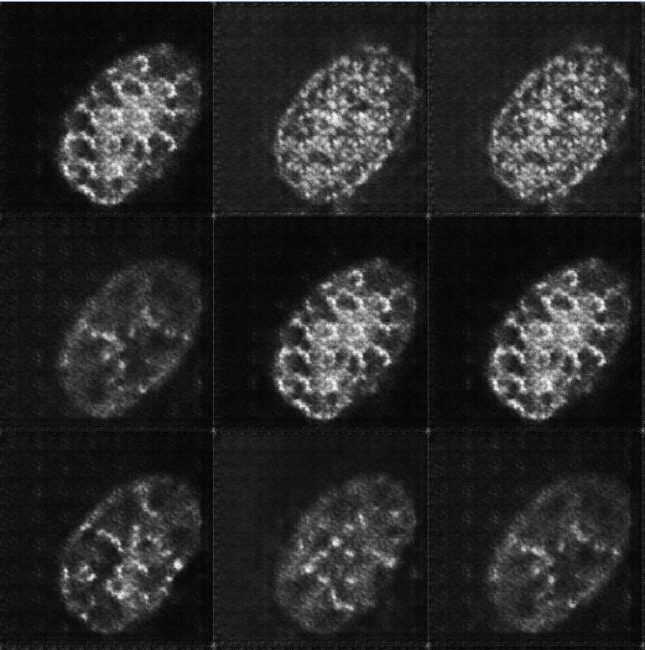
Sample Image for batch 3
Unconditional
Conditional

Slide 9
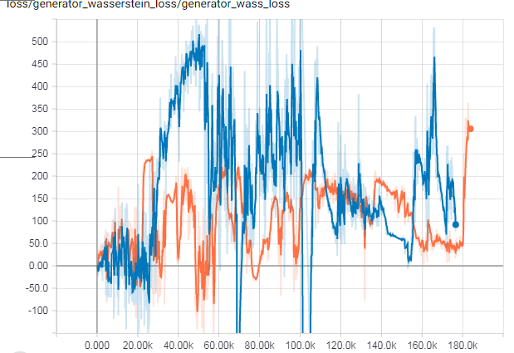
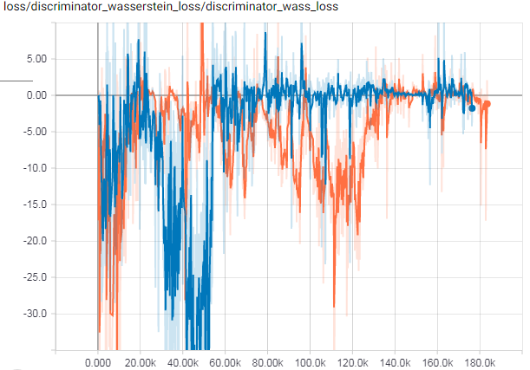
Loss for batch 4
Adam optimizor, [-4, -4], [-4, -4]

Slide 10
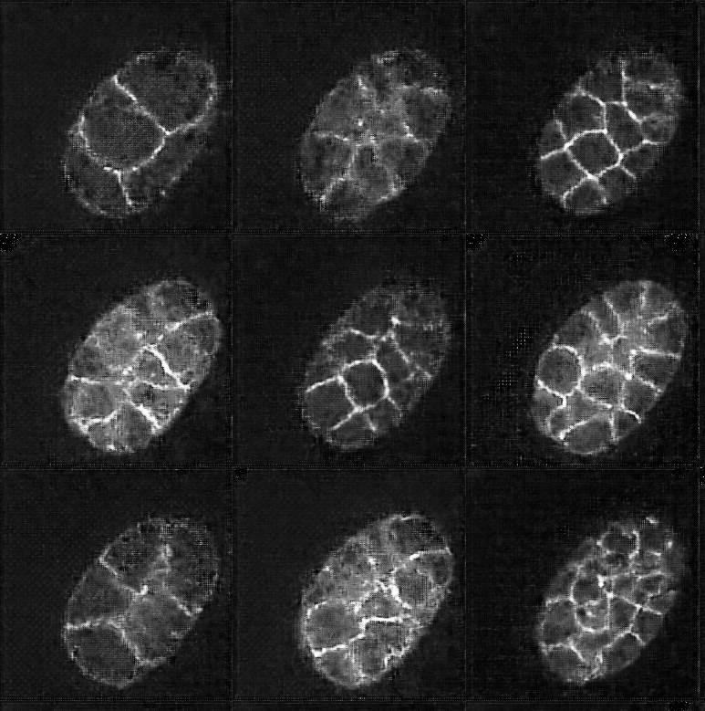
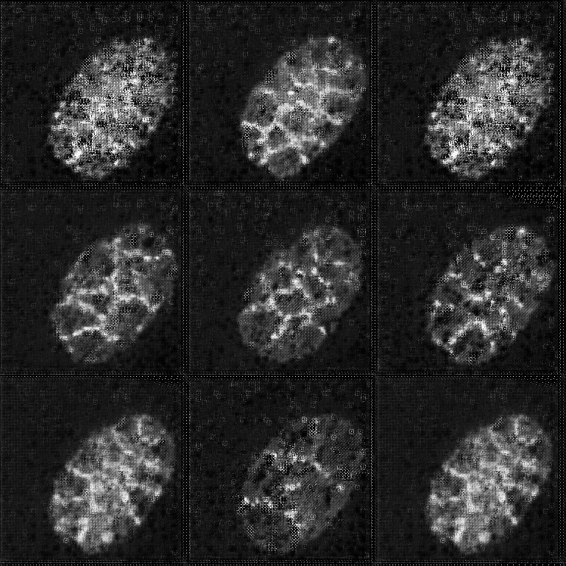
Sample Image for batch 4
Unconditional
Conditional

Slide 11
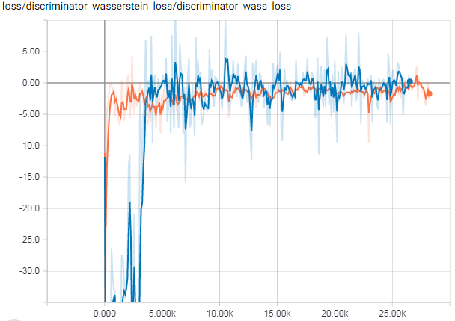
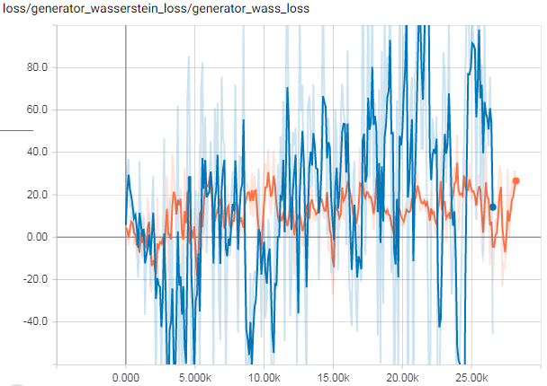
Loss for batch 5
Adam optimizor, [-4, -4], [-4, -4], down size to 128 and smaller network

Slide 12
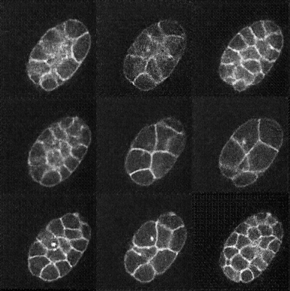
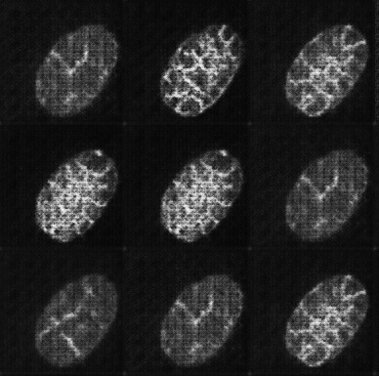
Sample Image for batch 5
Unconditional
Conditional

Slide 13
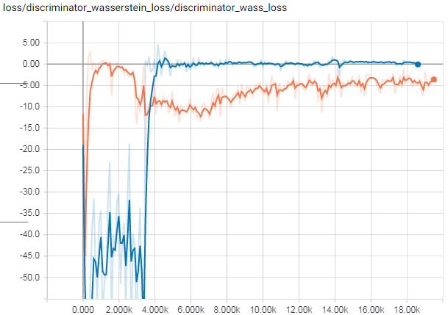
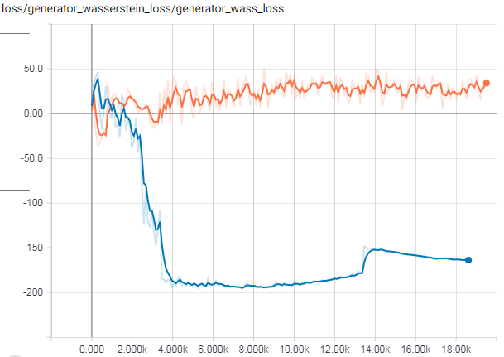
Loss for batch 6
Adam optimizor, [-4, -4], [-4, -4], down size to 128, leaky relu

Slide 14
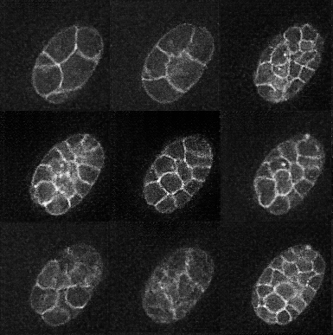
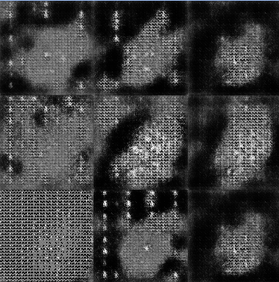
Sample Image for batch 6
Unconditional
Conditional

Slide 15
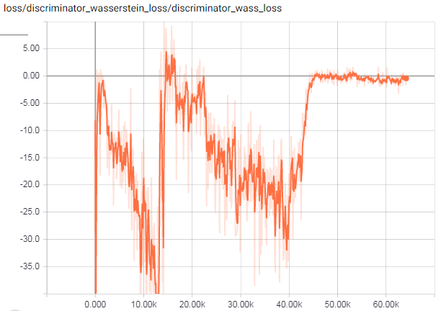
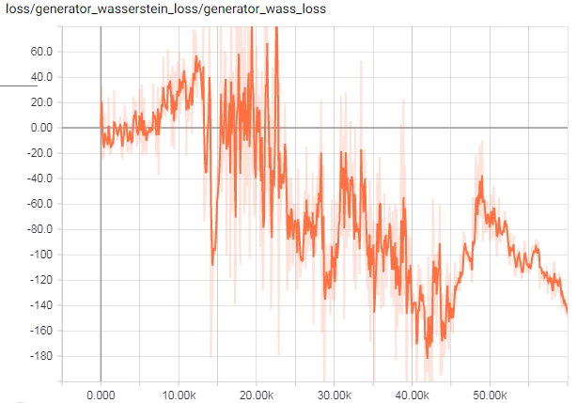
Loss for batch 7
Adam optimizor, [-4, -4], [-4, -4], down size to 128

Slide 16
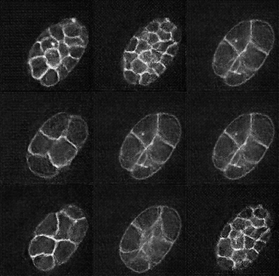
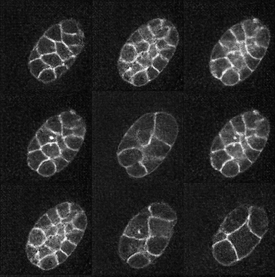
Sample Image for batch 7
At break point
In the end

Slide 17
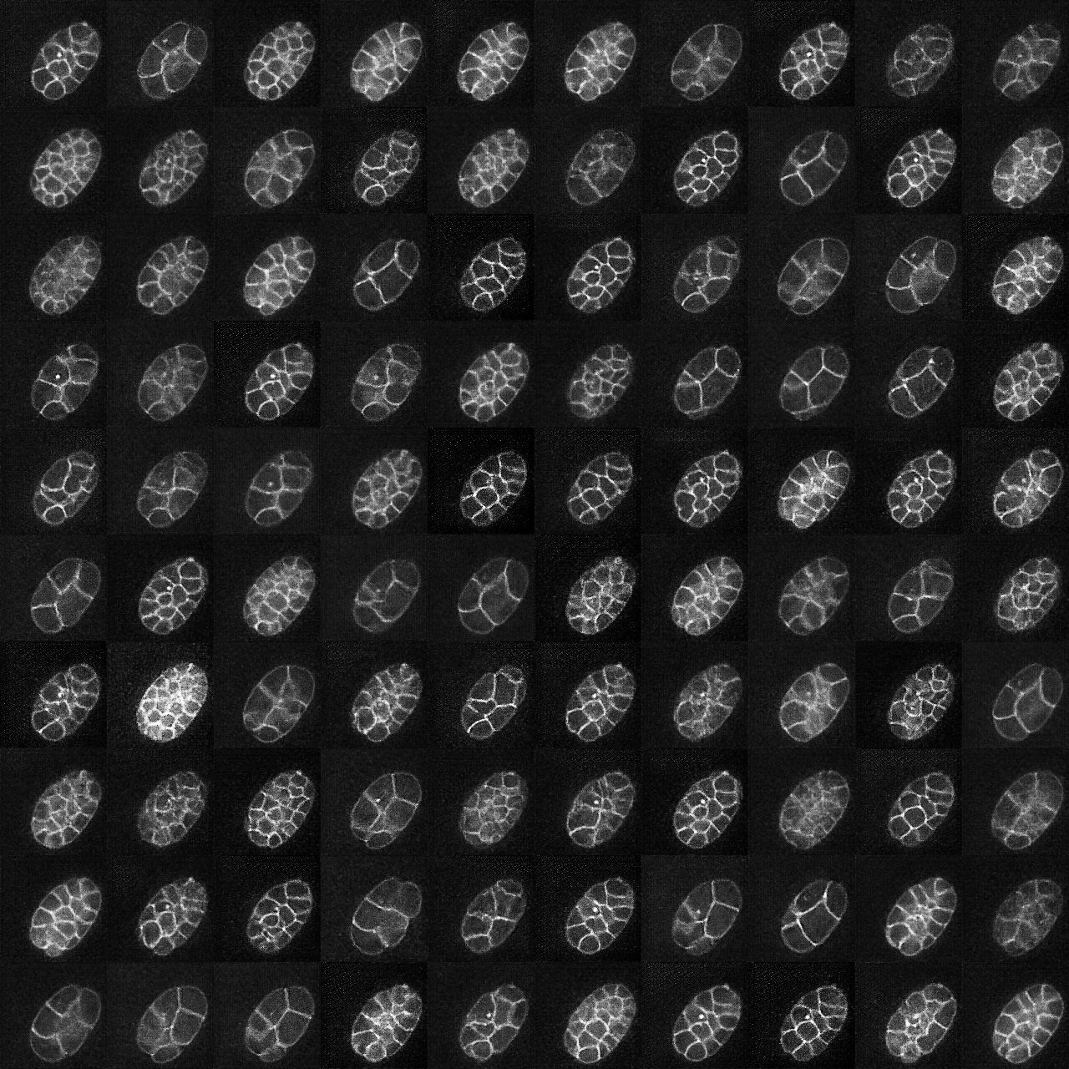
Final result (from batch 6) - unconditional

Slide 18
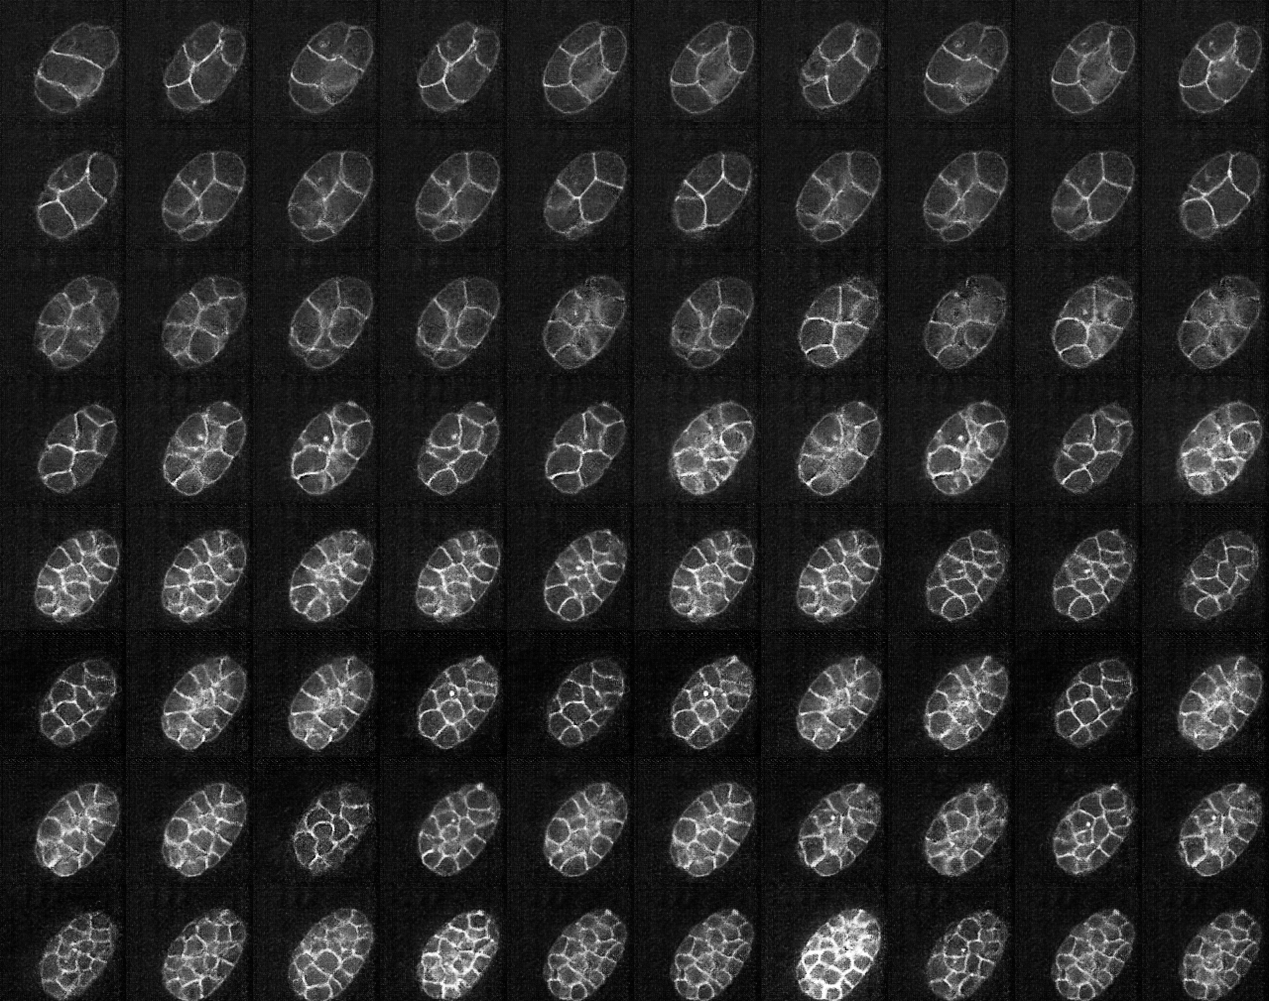
Final result (from batch 7) - unconditional

